Slide 1
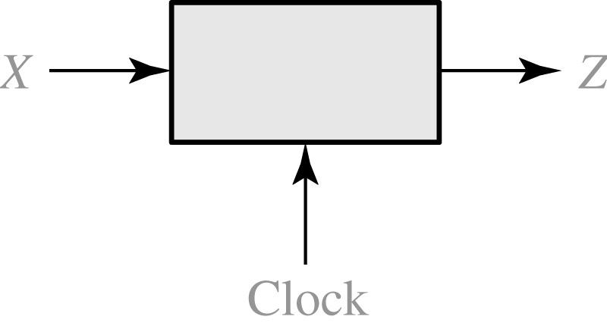
14.1 Design of a Sequence Detector
Fig 14-1 Sequence Detector (finding ‘101’) to be Designed
Search engine
Chat GPT
X = | 0 | 0 | 1 | 1 | 0 | 1 | 1 | 0 | 0 | 1 | 0 | 1 | 0 | 1 | 0 | 0
Z = | 0 | 0 | 0 | 0 | 0 | 1 | 0 | 0 | 0 | 0 | 0 | 1 | 0 | 1 | 0 | 0
(time: | 0 | 1 | 2 | 3 | 4 | 5 | 6 | 7 | 8 | 9 | 10 | 11 | 12 | 13 | 14 | 15)
Notes:
avian influenza virus

Slide 2
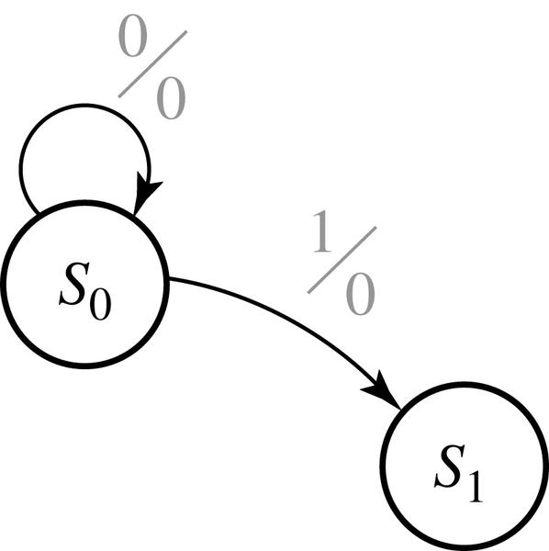
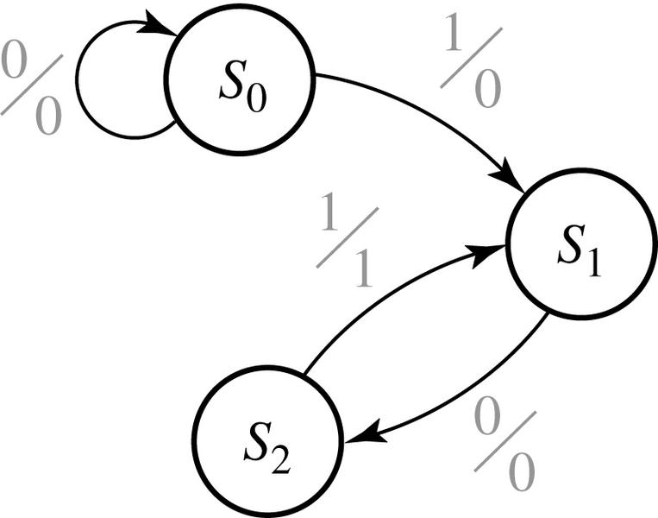
14.1 Design of a Sequence Detector
Fig 14-2 & 14-3 Formation of State Graph (finding ‘101’) (Mealy)
Stand by
Fire
Peace
Alarm
X = | 0 | 0 | 1 | 1 | 0 | 1 | 1 | 0 | 0 | 1 | 0 | 1 | 0 | 1 | 0 | 0
Z = | 0 | 0 | 0 | 0 | 0 | 1 | 0 | 0 | 0 | 0 | 0 | 1 | 0 | 1 | 0 | 0
(time: | 0 | 1 | 2 | 3 | 4 | 5 | 6 | 7 | 8 | 9 | 10 | 11 | 12 | 13 | 14 | 15)

Slide 3
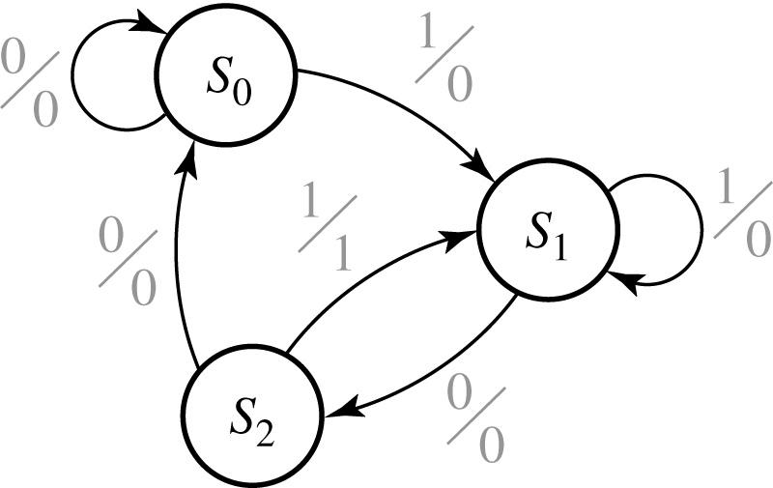
14.1 Design of a Sequence Detector
Fig 14-4 Mealy State Graph for Sequence Detector (finding ‘101’)
X = | 0 | 0 | 1 | 1 | 0 | 1 | 1 | 0 | 0 | 1 | 0 | 1 | 0 | 1 | 0 | 0
Z = | 0 | 0 | 0 | 0 | 0 | 1 | 0 | 0 | 0 | 0 | 0 | 1 | 0 | 1 | 0 | 0
(time: | 0 | 1 | 2 | 3 | 4 | 5 | 6 | 7 | 8 | 9 | 10 | 11 | 12 | 13 | 14 | 15)

Slide 4
14.1 Design of a Sequence Detector
Table 14-1 State Table
Present state |  | Next State |  | Present Output
 |  | X = 0 | X = 1 | X = 0 | X =1
S₀ S₁ S₂ |  | S₀ S₂ S₀ | S₁ S₁ S₁ | 0 0 0 | 0 0 1
Table 14-2 Transition Table with State Assignment (D-FFs)
AB |  | A⁺ B⁺ |  | Z
 |  | X = 0 | X = 1 | X = 0 | X =1
00 01 10 |  | 00 10 00 | 01 01 01 | 0 0 0 | 0 0 1

Slide 5
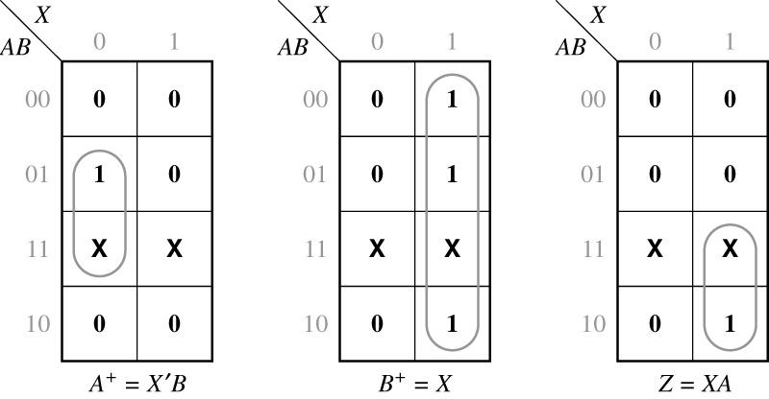
14.1 Design of a Sequence Detector
Maps for the next states A⁺ and B⁺ and the output function Z

Slide 6
14.1 Design of a Sequence Detector
K-Maps from the State tables
AB |  | A⁺ B⁺ |  | Z
 |  | X = 0 | X = 1 | X = 0 | X =1
00 01 10 |  | 00 10 00 | 01 01 01 | 0 0 0 | 0 0 1

Slide 7
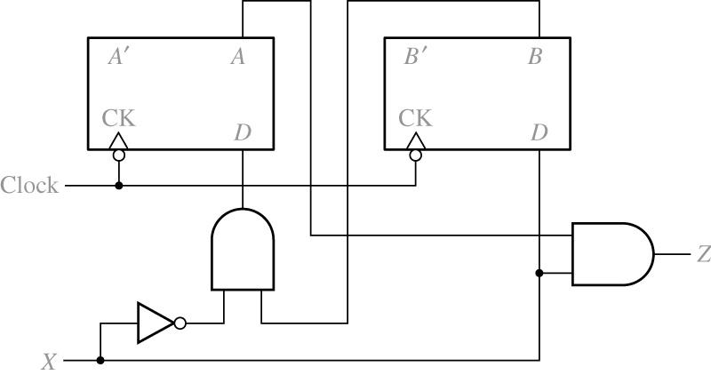
14.1 Design of a Sequence Detector
Fig 14-5 Final Circuit

Slide 8
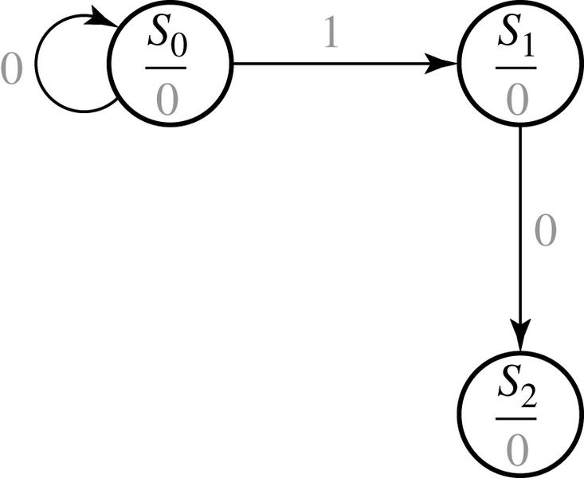
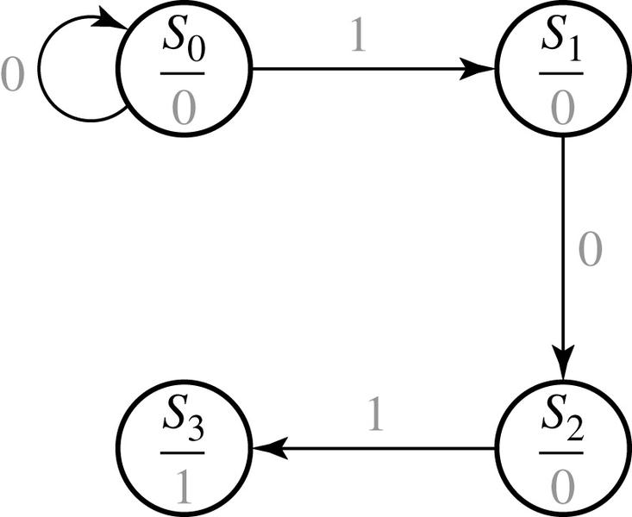
14.1 Design of a Sequence Detector
Moore Machine Design Process ‘101’
Peace
Stand by
Fire
Alarm
X = | 0 | 0 | 1 | 1 | 0 | 1 | 1 | 0 | 0 | 1 | 0 | 1 | 0 | 1 | 0 | 0
Z = | 0 | 0 | 0 | 0 | 0 | 1 | 0 | 0 | 0 | 0 | 0 | 1 | 0 | 1 | 0 | 0
(time: | 0 | 1 | 2 | 3 | 4 | 5 | 6 | 7 | 8 | 9 | 10 | 11 | 12 | 13 | 14 | 15)

Slide 9
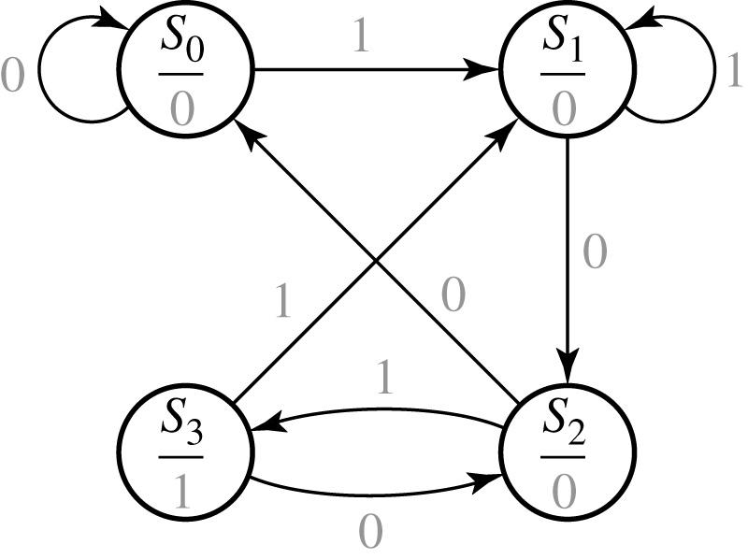
14.1 Design of a Sequence Detector
Fig 14-6 Moore State Graph for Sequence ‘101’ Detector
Each state includes output.
That’s why Moore type has one more state (S₃)
X = | 0 | 0 | 1 | 1 | 0 | 1 | 1 | 0 | 0 | 1 | 0 | 1 | 0 | 1 | 0 | 0
Z = | 0 | 0 | 0 | 0 | 0 | 1 | 0 | 0 | 0 | 0 | 0 | 1 | 0 | 1 | 0 | 0
(time: | 0 | 1 | 2 | 3 | 4 | 5 | 6 | 7 | 8 | 9 | 10 | 11 | 12 | 13 | 14 | 15)

Slide 10
14.1 Design of a Sequence Detector
Table 14-3 State Table
Table 14-4 Transition Table with State assignment
Present state | Next State X = 0 X = 1 | Present Output (Z)
S₀ S₁ S₂ S₃ | S₀ S₂ S₀ S₂ S₁ S₁ S₃ S₁ | 0 0 0 1
AB | A⁺ B⁺ X = 0 X = 1 |  | Z
00 01 10 11 | 00 10 00 10 | 01 01 11 01 | 0 0 0 1
Current state S AB | Next state⁺ X=0 X=1 | A⁺ B⁺ X=0 X=1 | Output Z
S₀ 00 | S₀ S₁ | 00 01 | 0
S₁ 01 | S₂ S₁ | 01 | 0
S₂ 10 | S₀ S₃ | 00 11 | 0
S₃ 11 | S₂ S₁ | 10 01 | 1

Slide 11
14.1 Design of a Sequence Detector
Current state S AB | Next state⁺ X=0 X=1 | A⁺ B⁺ X=0 X=1 | Output Z
S₀ 00 | S₀ S₁ | 00 01 | 0
S₁ 01 | S₂ S₁ | 01 | 0
S₂ 10 | S₀ S₃ | 00 11 | 0
S₃ 11 | S₂ S₁ | 10 01 | 1
K-map for D-FF
D_{A}
D_{B}
Z
 | 0 | 1
00 | 0 | 0
01 | 1 | 0
11 | 1 | 0
10 | 0 | 1
 | 0 | 1
00 | 0 | 1
01 | 0 | 1
11 | 0 | 1
10 | 0 | 1
 | 0 | 1
00 | 0 | 0
01 | 0 | 0
11 | 1 | 1
10 | 0 | 0

Slide 12
14.1 Design of a Sequence Detector
‘101’ SD w/ Mealy & T-FFs
Frequent BAD example
Present state | Next State X = 0 X = 1 | Present Output (Z)
S₀ S₁ S₂ S₃ | S₀ S₂ S₀ S₂ S₁ S₁ S₃ S₁ | 0 0 0 1
AB | A⁺ B⁺ X = 0 X = 1 |  | Z
00 01 10 11 | 00 10 00 10 | 01 01 11 01 | 0 0 0 1
T-FF E-Table
Current state S AB | Next state⁺ X=0 X=1 | A⁺ B⁺ X=0 X=1 | Output Z | T_{A}T_{B} X=0 X=1
S₀ 00 | S₀ S₁ | 00 01 | 0 | 00 01
S₁ 01 | S₂ S₁ | 01 | 0 | 00
S₂ 10 | S₀ S₃ | 00 11 | 0 | 01
S₃ 11 | S₂ S₁ | 10 01 | 1 | 01 10
Q | Q⁺ | T
0 | 0 | 0
0 | 1 | 1
1 | 0 | 1
1 | 1 | 0

Slide 13
14.1 Design of a Sequence Detector
Current state S AB | Next state⁺ X=0 X=1 | A⁺ B⁺ X=0 X=1 | Output Z | T_{A}T_{B} X=0 X=1
S₀ 00 | S₀ S₁ | 00 01 | 0 | 00 01
S₁ 01 | S₂ S₁ | 01 | 0 | 00
S₂ 10 | S₀ S₃ | 00 11 | 0 | 01
S₃ 11 | S₂ S₁ | 10 01 | 1 | 01 10
K-map for T-FF
T_{A}
T_{B}
Z
 | 0 | 1
00 | 0 | 0
01 | 1 | 0
11 | 1 | 1
10 | 0 | 0
 | 0 | 1
00 | 0 | 1
01 | 1 | 0
11 | 1 | 0
10 | 0 | 1
 | 0 | 1
00 | 0 | 0
01 | 0 | 0
11 | 1 | 1
10 | 0 | 0

